Slide 1
Chapter 6:
More on the Selection Structure

Slide 2
Objectives
Include a nested selection structure in pseudocode and in a flowchart
Code a nested selection structure
Recognize common logic errors in selection structures
Include a multiple-alternative selection structure in pseudocode and in a flowchart
Code a multiple-alternative selection structure in C++
An Introduction to Programming with C++, Seventh Edition

Slide 3
Making Decisions
True and false paths of a selection structure can contain other selection structures
Inner selection structures are referred to as nested selection structures; contained (nested) within an outer selection structure
Nested selection structures are used when more than one decision needs to be made before choosing an instruction
Inner (nested) selection structures are indented within their outer selection structures
An Introduction to Programming with C++, Seventh Edition

Slide 4
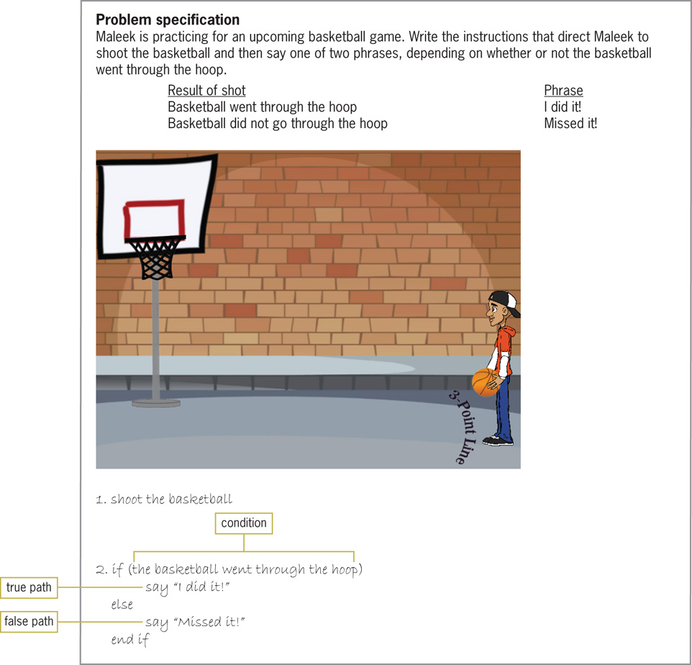
Making Decisions (cont’d.)
Figure 6-1 Problem that requires a selection structure
An Introduction to Programming with C++, Seventh Edition

Slide 5
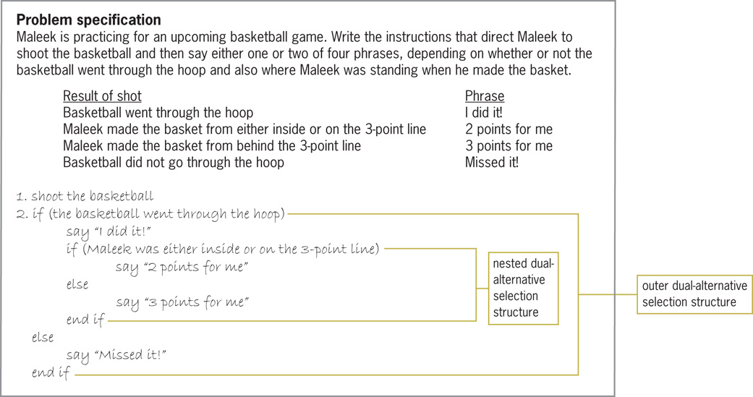
Making Decisions (cont’d.)
Figure 6-2 Problem that requires a nested selection structure
An Introduction to Programming with C++, Seventh Edition

Slide 6
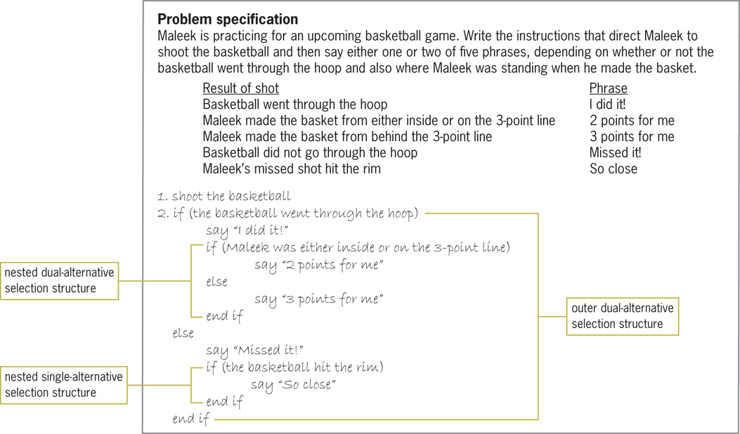
Making Decisions (cont’d.)
Figure 6-3 Problem that requires two nested selection structures
An Introduction to Programming with C++, Seventh Edition

Slide 7
Flowcharting a Nested Selection Structure
Outer and inner selection structures can be thought of as making primary and secondary decisions, respectively
Secondary decision is called such because whether it needs to be made depends on the result of a primary decision
An Introduction to Programming with C++, Seventh Edition

Slide 8
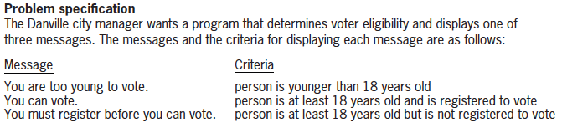
Flowcharting a Nested Selection Structure (cont’d.)
Figure 6-6 Problem specification for voter eligibility problem
An Introduction to Programming with C++, Seventh Edition

Slide 9
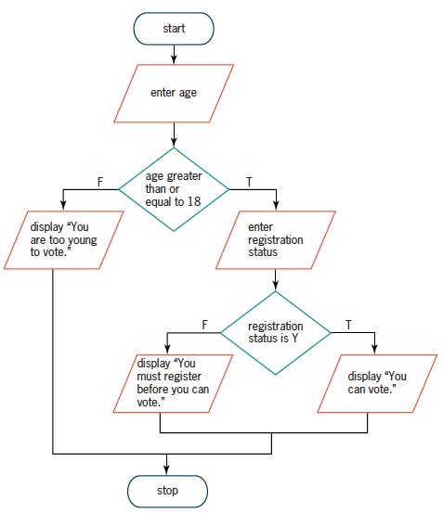
Flowcharting a Nested Selection Structure (cont’d.)
Figure 6-6 A correct solution to the voter eligibility problem
An Introduction to Programming with C++, Seventh Edition

Slide 10
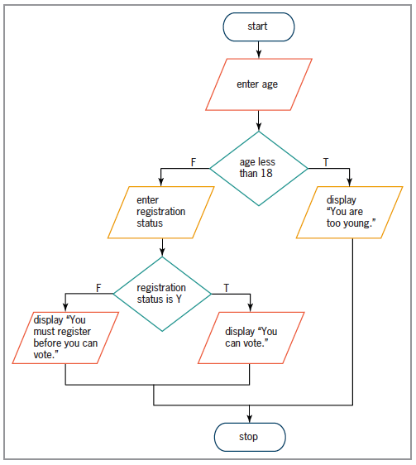
Flowcharting a Nested Selection Structure (cont’d.)
Figure 6-7 Another correct solution to the voter eligibility problem
An Introduction to Programming with C++, Seventh Edition

Slide 11
Coding a Nested Selection Structure
Code for nested selection structures uses the if and else statements
Nested selection structures can be placed in either if or else statement blocks
Correct tabbing makes code easier to read
An Introduction to Programming with C++, Seventh Edition

Slide 12
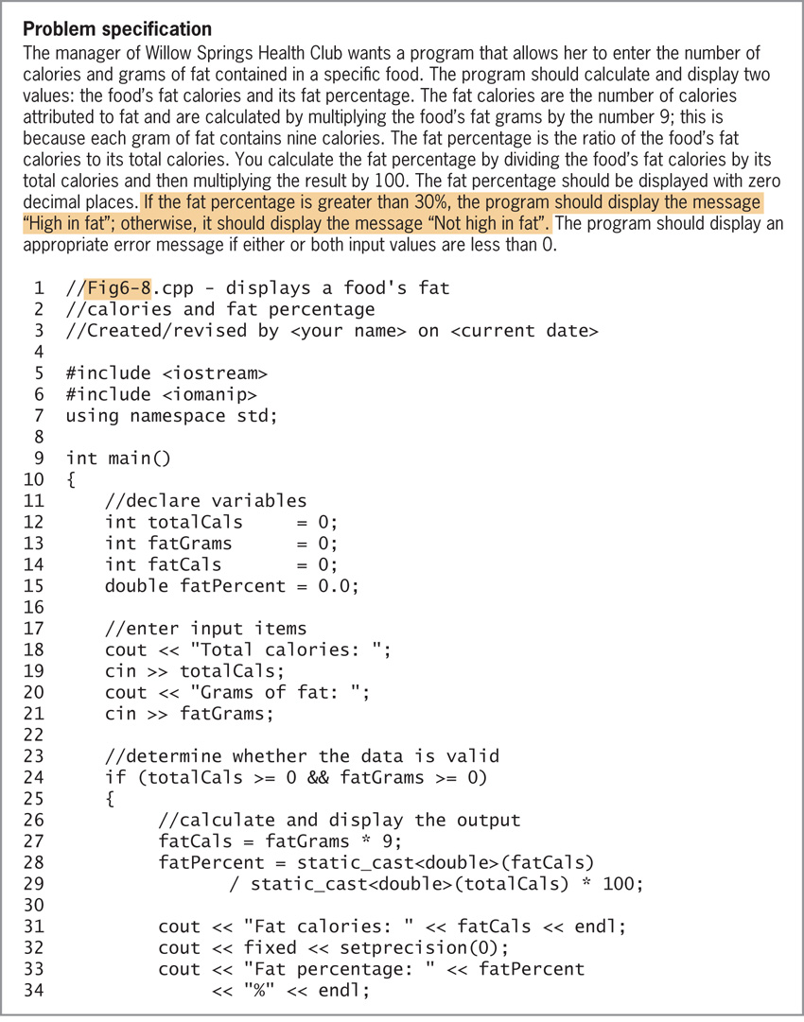
Coding a Nested Selection Structure (cont’d.)
Figure 6-8 Modified problem specification for the
health club problem from Chapter 5’s Lab 5-2
An Introduction to Programming with C++, Seventh Edition

Slide 13
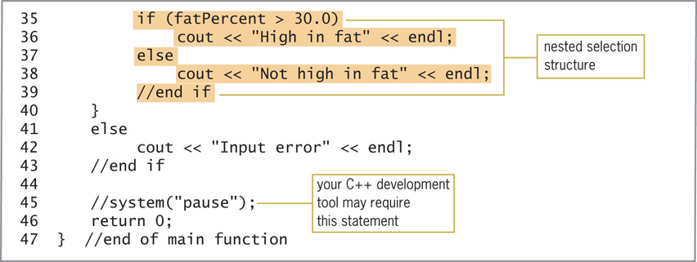
Coding a Nested Selection Structure (cont’d.)
Figure 6-8 Modified problem specification for the
health club problem from Chapter 5’s Lab 5-2 (cont’d)
An Introduction to Programming with C++, Seventh Edition

Slide 14
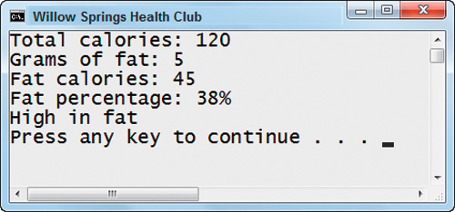
Coding a Nested Selection Structure (cont’d.)
Figure 6-9 Sample run of the modified health club program
An Introduction to Programming with C++, Seventh Edition

Slide 15
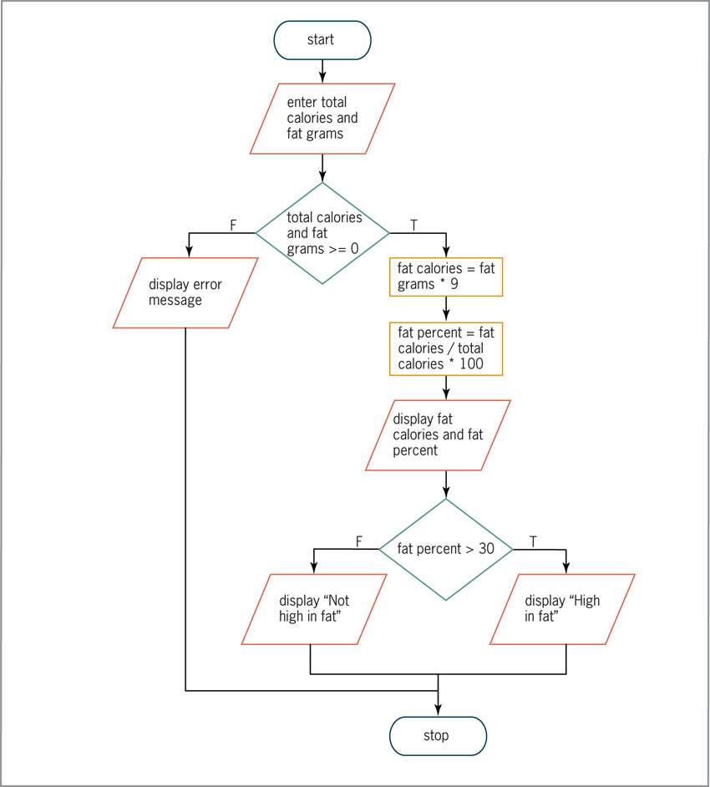
Coding a Nested Selection Structure (cont’d.)
Figure 6-10 Flowchart for the modified health club program
An Introduction to Programming with C++, Seventh Edition

Slide 16
Logic Errors in Selection Structures
Three common logic errors made when writing selection structures
  Using a compound condition rather than a nested selection structure
  Reversing the outer and nested decisions
  Using an unnecessary nested selection structure
An Introduction to Programming with C++, Seventh Edition

Slide 17
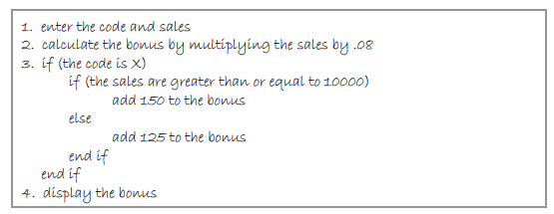
Logic Errors in Selection Structures (cont’d.)
Figure 6-11 A correct algorithm for the bonus problem
An Introduction to Programming with C++, Seventh Edition

Slide 18
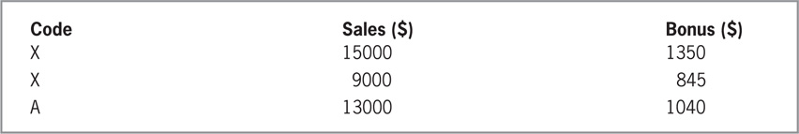


Logic Errors in Selection Structures (cont’d.)
Figure 6-12 Test data and manually calculated results
Figure 6-13 Current status of the desk-check table
Figure 6-14 Desk-check table after completing the first desk-check
An Introduction to Programming with C++, Seventh Edition

Slide 19
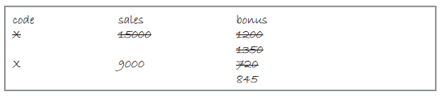
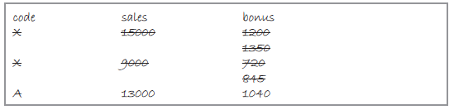
Logic Errors in Selection Structures (cont’d.)
Figure 6-15 Desk-check table after completing the second desk-check
Figure 6-16 Desk-check table after completing the third desk-check
An Introduction to Programming with C++, Seventh Edition

Slide 20
First Logic Error
Using a compound condition rather than a nested selection structure
Ignores the hierarchy between two sub-conditions – One applies only if the other is a certain value
An Introduction to Programming with C++, Seventh Edition

Slide 21
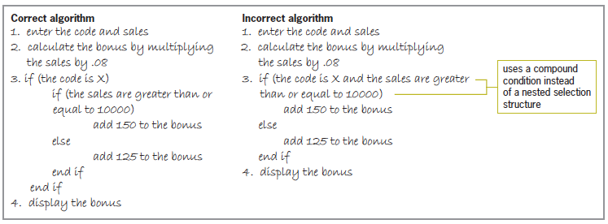
First Logic Error (cont’d.)
Figure 6-17 Correct algorithm and incorrect algorithm containing the first logic error
An Introduction to Programming with C++, Seventh Edition

Slide 22
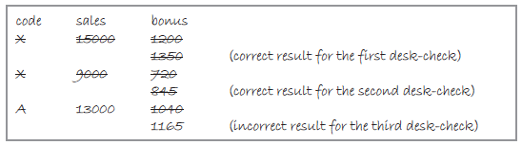
First Logic Error (cont’d.)
Figure 6-18 Desk-check table for the incorrect algorithm in Figure 6-17
An Introduction to Programming with C++, Seventh Edition

Slide 23
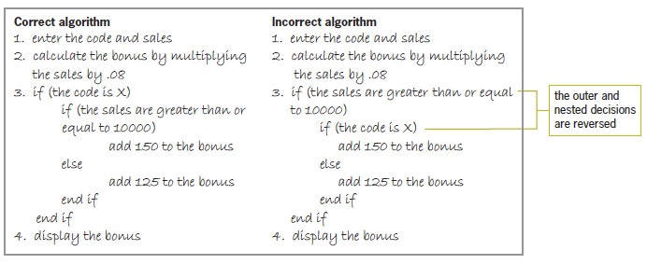
Second Logic Error
Reversing outer and nested selection structures
Figure 6-19 Correct algorithm and an incorrect
algorithm containing the second logic error
An Introduction to Programming with C++, Seventh Edition

Slide 24
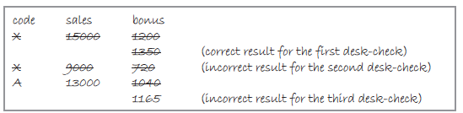
Second Logic Error (cont’d.)
Figure 6-20 Desk-check table for the incorrect algorithm in Figure 6-19
An Introduction to Programming with C++, Seventh Edition

Slide 25
Third Logic Error
Using an unnecessary nested selection structure
Often will produce the correct result, but will be inefficient
An Introduction to Programming with C++, Seventh Edition

Slide 26
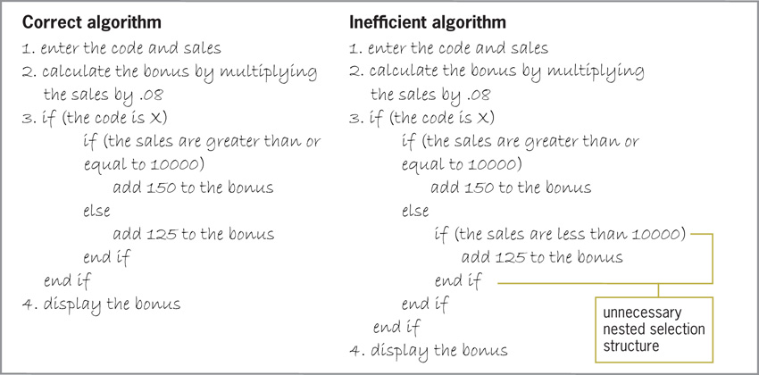
Third Logic Error (cont’d.)
Figure 6-21 Correct algorithm and an incorrect
algorithm containing the third logic error
An Introduction to Programming with C++, Seventh Edition

Slide 27
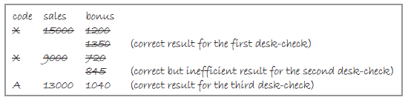
Third Logic Error (cont’d.)
Figure 6-22 Desk-check table for inefficient algorithm in Figure 6-21
An Introduction to Programming with C++, Seventh Edition

Slide 28
Multiple-Alternative Selection Structures
Sometimes problems require a selection structure that chooses between several alternatives
Called multiple-alternative selection structures or extended selection structures
In a flowchart, diamond symbol is used; has multiple flowlines leading out, not just two
Each flowline represents a possible path, marked with the value that represents that path
if/else statements can be used to implement it; uses multiple if else clauses
An Introduction to Programming with C++, Seventh Edition

Slide 29
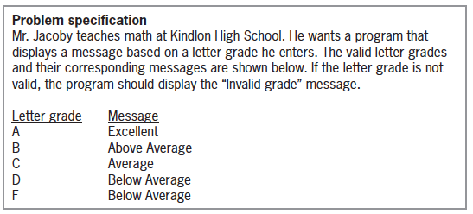
Multiple-Alternative Selection Structures (cont’d.)
Figure 6-25 Problem specification for Kindlon High School problem
An Introduction to Programming with C++, Seventh Edition

Slide 30
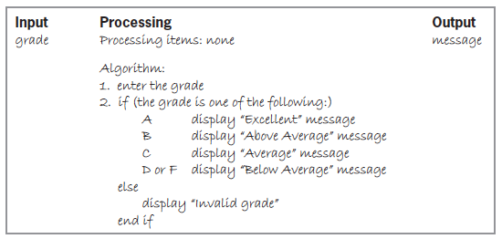
Multiple-Alternative Selection Structures (cont’d.)
Figure 6-25 IPO chart for the Kindlon High School problem
An Introduction to Programming with C++, Seventh Edition

Slide 31
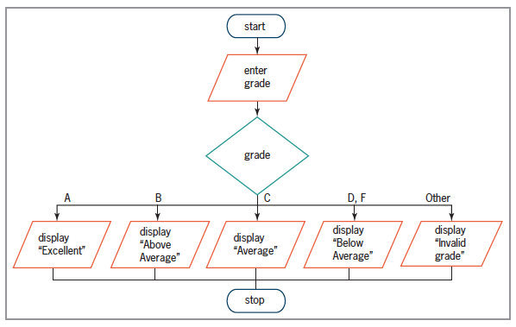
Multiple-Alternative Selection Structures (cont’d.)
Figure 6-26 Flowchart for the Kindlon High School problem
An Introduction to Programming with C++, Seventh Edition

Slide 32
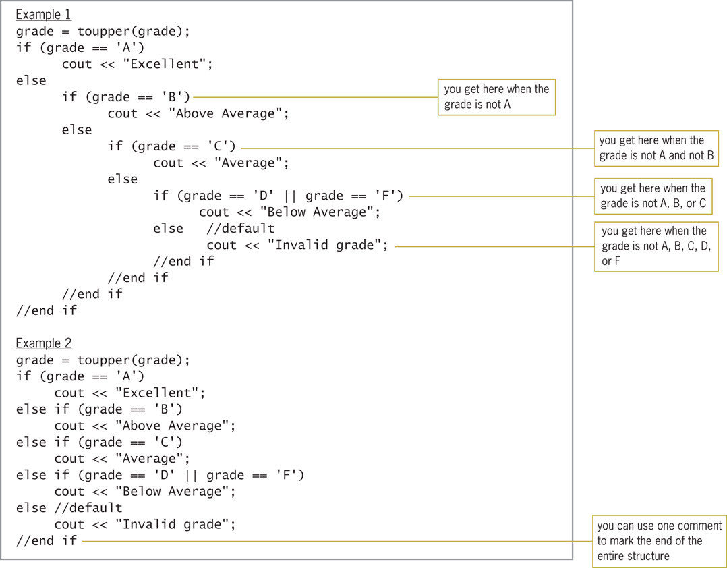
Multiple-Alternative Selection Structures (cont’d.)
Figure 6-27 Two ways of coding the multiple-alternative
selection structure from Figures 6-25 and 6-26
An Introduction to Programming with C++, Seventh Edition

Slide 33
The switch Statement
Can sometimes use the switch statement to code a multiple-alternative selection structure
Statement begins with switch keyword followed by a selector expression in parentheses
Selector expression can contain any combination of variables, constants, functions, and operators
Must result in a data type that is bool, char, short, int, or long
Between opening and closing braces (after selector expression), there are one or more case clauses
An Introduction to Programming with C++, Seventh Edition

Slide 34
The switch Statement (cont’d.)
Each case clause represents a different alternative and contains a value followed by a colon
Can include as many case clauses as necessary
Value for each case clause can be a literal constant, named constant, or an expression composed of literal and named constants
Data type of the value should be the same data type as the selector expression
An Introduction to Programming with C++, Seventh Edition

Slide 35
The switch Statement (cont’d.)
Each case clause contains one or more statements processed when selector expression matches that case’s value
break statement tells computer to break out of switch at that point; must be the last statement of a case clause
Without a break statement, computer continues to process instructions in later case clauses
After processing break, computer processes next instruction after switch statement’s closing brace
An Introduction to Programming with C++, Seventh Edition

Slide 36
The switch Statement (cont’d.)
Good programming practice to document end of switch with a comment (//end switch)
Can also include one default clause; processed if selector expression does not match any values in case clauses
default clause can appear anywhere, but usually entered as last clause
  If it is the last clause, a break statement is not needed at its end
  Otherwise, a break statement is needed to prevent computer from processing later case clauses
An Introduction to Programming with C++, Seventh Edition

Slide 37
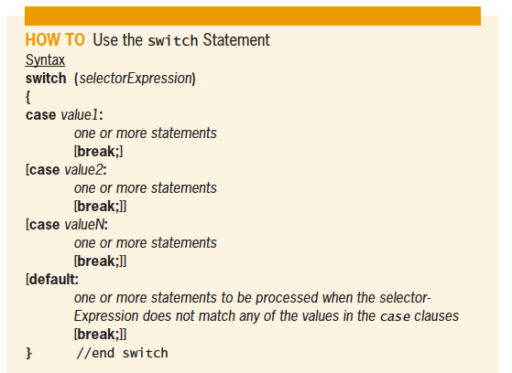
The switch Statement (cont’d.)
Figure 6-28 How to use the switch statement
An Introduction to Programming with C++, Seventh Edition

Slide 38
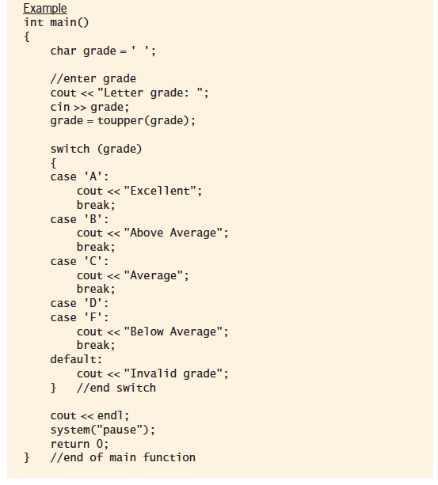
The switch Statement (cont’d.)
Example similar to code in Figure 6-28
An Introduction to Programming with C++, Seventh Edition

Slide 39
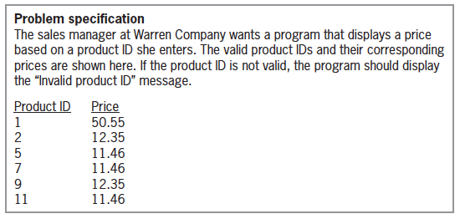
The switch Statement (cont’d.)
Figure 6-29 Problem specification for the Warren Company problem
An Introduction to Programming with C++, Seventh Edition

Slide 40
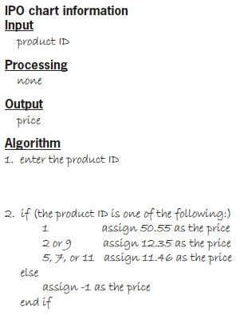

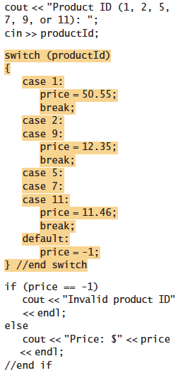
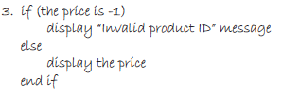
The switch Statement (cont’d.)
Figure 6-29 IPO chart and C++ instructions for the Warren Company problem
An Introduction to Programming with C++, Seventh Edition

Slide 41
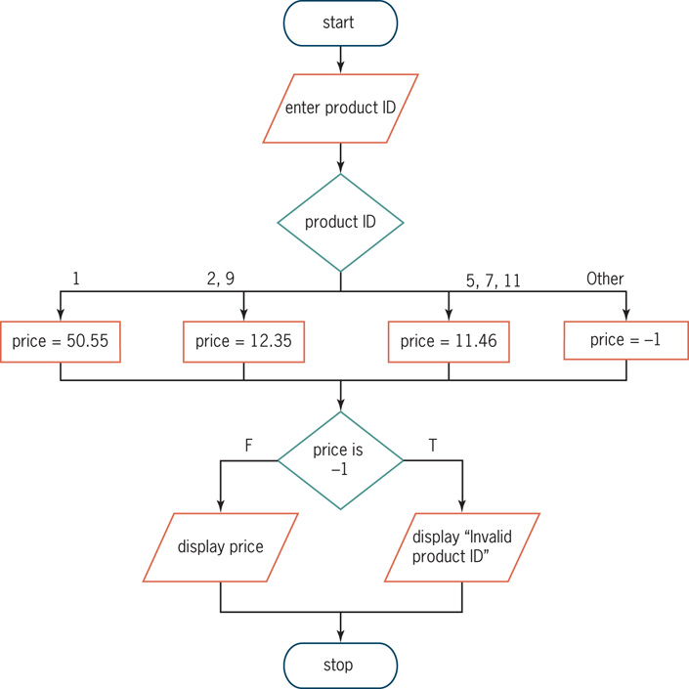
The switch Statement (cont’d.)
Figure 6-30 Flowchart for the Warren Company problem
An Introduction to Programming with C++, Seventh Edition

Slide 42
Summary
Can nest a selection structure within true or false path of another selection structure
Three common logic errors when writing selection structures
  Using a compound condition instead of a nested selection structure
  Reversing the inner and outer selection structures
  Using an unnecessary nested selection structure
An Introduction to Programming with C++, Seventh Edition

Slide 43
Summary (cont’d.)
Some solutions require selection structures that choose from multiple alternatives; called multiple-alternative or extended selection structures
Can code these either with if/else statements or the switch statement
Diamond is used to represent multiple-alternative selection structures in a flowchart
Has multiple flowlines leading out; each representing a possible path and marked with appropriate values
An Introduction to Programming with C++, Seventh Edition

Slide 44
Summary (cont’d.)
In a switch statement, the data type of the value in each case clause must be compatible with data type of selector expression
Selector expression must evaluate to value of type bool, char, short, int, or long
Most case clauses contain a break statement; tells the computer to leave the switch statement
Good practice to mark end of switch statement with a comment (//end switch)
An Introduction to Programming with C++, Seventh Edition

Slide 45
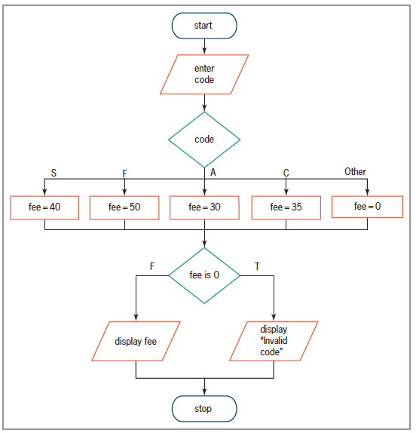
Lab 6-1: Stop and Analyze
Figure 6-31 Flowchart for Lab 6-1
An Introduction to Programming with C++, Seventh Edition

Slide 46
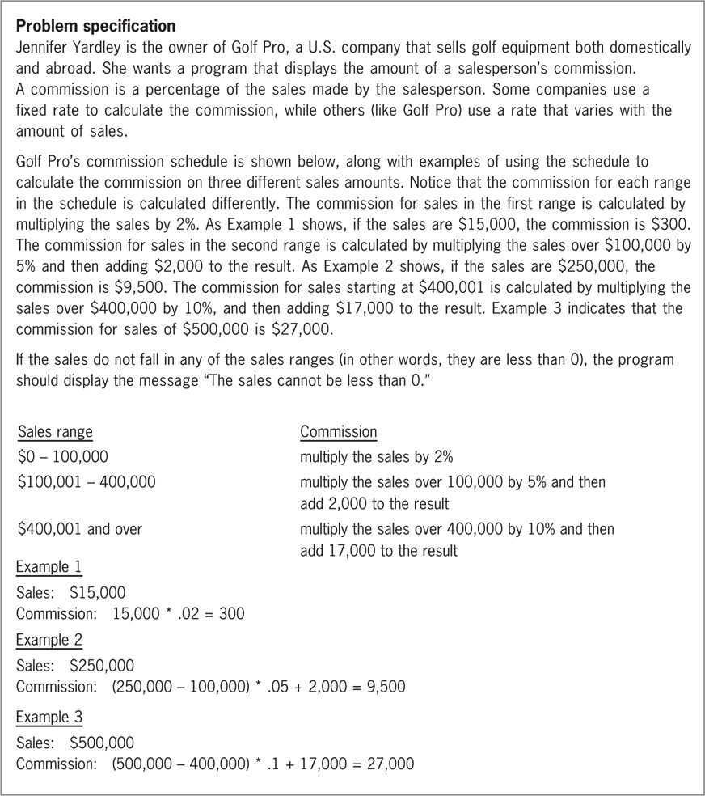
Lab 6-2: Plan and Create
Figure 6-32 Problem specification and
calculation examples for Lab 6-2
An Introduction to Programming with C++, Seventh Edition

Slide 47

Lab 6-3: Modify
Modify the program in Lab 6-2 to calculate commission based on information in Figure 6-38
If the sales are less than zero, display “The sales cannot be less than zero.”
If the code is not 1, 2, or 3, display “Invalid Code”
Figure 6-38 Problem specification for Lab 6-3
An Introduction to Programming with C++, Seventh Edition

Slide 48
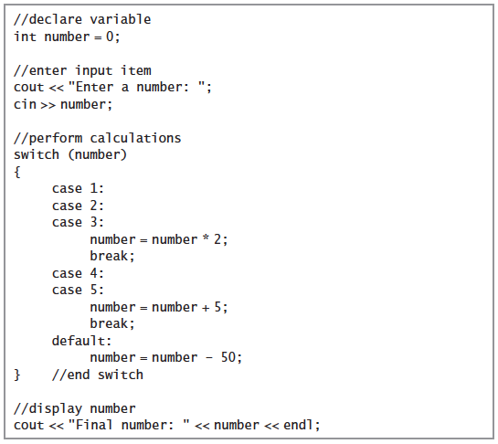
Lab 6-4: Desk-Check
Figure 6-39 Code for Lab 6-4
An Introduction to Programming with C++, Seventh Edition

Slide 49
Lab 6-5: Debug
Follow the instructions for starting C++ and opening the Lab6-5.cpp file
Test the program using codes 1, 2, 3, 4, 5, 9, and -3
Debug the program
An Introduction to Programming with C++, Seventh Edition

